Slide 1

Applications of Blockchain
Loke KS

Slide 2
Reference
Joseph J. Bambara & Paul R. Allen. Blockchain A Practical Guide to Developing Business, Law, and Technology Solutions. McGraw Hill Education, 2018.
https://link.springer.com/book/10.1007/978-981-13-8775-3
https://link.springer.com/search?query=blockchain

Slide 3
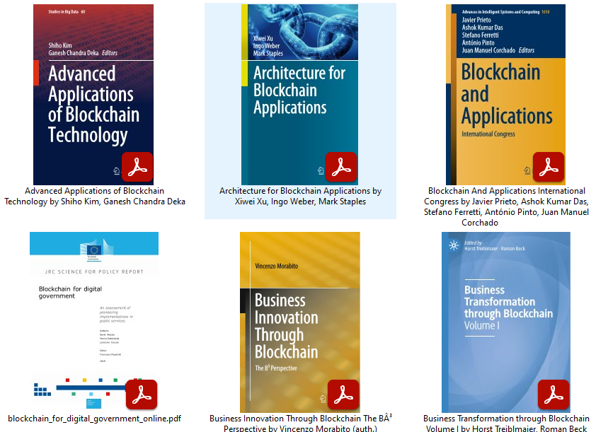
Reference

Slide 4
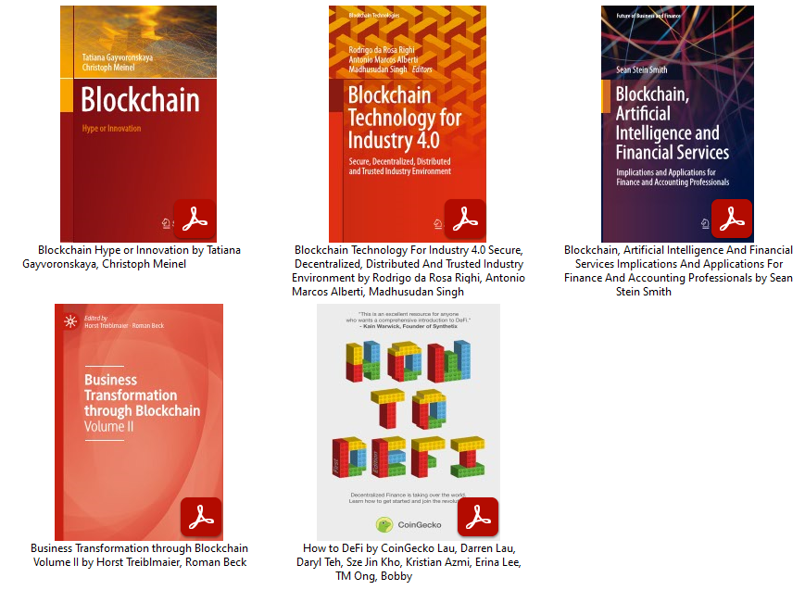
Reference

Slide 5
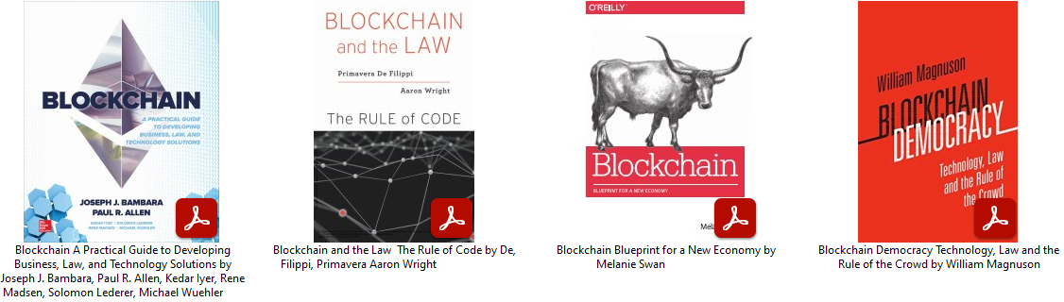
Reference

Slide 6
Introduction
We discuss some possible applications and characteristics on the Blockchain
However be critical of what is being presented – not every thing is true ☺

Slide 7
Colored Coin
Colored coins is a concept which allows one to associate additional properties with transaction outputs ("coins") in context of Bitcoin-like blockchain.
This can be used to represent ownership of external objects within the blockchain and, particularly, it can be used for issuance of securities (such as stocks and bonds), private currencies, etc.
Colored coins were created as a way to issue and transfer assets on the Bitcoin blockchain. A colored coin can be issued to represent anything at all, including stocks, bonds, commodities, real estate, fiat currencies and even other cryptocurrencies.
https://en.bitcoin.it/wiki/Colored_Coins

Slide 8
Colored Coin
When a transaction output which has additional properties associated with it is spent in a transaction, these properties might be transferred to outputs of that transaction. A special set of rules (color kernel, see below) is used to determine whether and how this transfer happens.
Thus, we can assume that a party which is able to spend a transaction output which has an additional property associated with it is the current owner of that property, and when he spends that transaction output he transfers ownership of that property to a different party.

Slide 9
Colored Coin
A company could issue colored coins representing shares. The shares could then be traded frictionlessly through the Bitcoin infrastructure.
A bank could issue colored coins backed by a cash reserve. People could withdraw and deposit money in colored coins, and trade those, or use them to pay for goods and services. The Blockchain becomes a system allowing to transact not only in Bitcoin, but in any currency.
Locks on cars or houses could be associated with a particular type of colored coins. The door would only open when presented with a wallet containing that specific coin.
Notes:
Acts like coupons, chips, etc

Slide 10
Colored Coin Implementations
EPOBC is the first Colored coins implementation which was created By ChromaWay. EPOBC doesn't use op_return to store metadata on the blockchain
Open Assets is a Colored Coin implementation based on the OP_RETURN operator. Metadata is linked from the Blockchain and stored on the web

Slide 11
Colored Coin
Bitcoin's scripting language allows to store small amounts of metadata on the blockchain, which can be used to represent asset manipulation instructions.
For example, we can encode in a Bitcoin transaction that 100 units of a new asset were issued and are now credited to a given bitcoin address. A colored coins wallet can create a Bitcoin transaction that encodes sending 50 units of an asset from one address to a new address, and so on.

Slide 12
Colored Coin
The advantage of using Bitcoin's blockchain as the backbone leverages Bitcoin's strengths, such as immutability, non-counterfeitability, ease of transfer, robustness and transparency thus allowing asset manipulation with unprecedented security and ease.

Slide 13
Colored Coins - Use Cases
A company can issue shares using colored coins, taking advantage of the Bitcoin infrastructure for activities such as
Trading
Voting
Paying dividends

Slide 14
Colored Coins - Use Cases
Coupon
A company may wish to issue coupons, such as Air Miles rewards points
Community Money
A community. e.g. a town, can issue it's own Currency.
Digital collectibles
Decentralized management of digital assets. Just like art collectors buy and sell original copies of famous paintings for millions of dollars today, colored coins allow us to do the same with purely digital objects, such as songs, movies, e-books and software, as well, by storing the current ownership of the work as a colored coin on the blockchain

Slide 15
Smart Property
Smart property is property whose ownership is controlled via the Bitcoin block chain, using contracts. Examples could include physical property such as cars, phones or houses. Smart property also includes non-physical property like shares in a company or access rights to a remote computer. Making property smart allows it to be traded with radically less trust.
This reduces fraud, mediation fees and allows trades to take place that otherwise would never have happened. For example, it allows strangers to loan you money over the internet taking your smart property as collateral, which should make lending more competitive and thus credit cheaper.
https://en.bitcoin.it/wiki/Smart_Property

Slide 16
Smart Property
Primitive forms of smart property are already common - if you own a car, it probably comes with an immobilizer. Immobilizers augment the physical key with a protocol exchange ensuring only the holders of the correct cryptographic token can activate the engine. They have dramatically reduced car theft, for example, immobilisers are fitted to around 45% of all cars in Australia, but account for only 7% of the cars that are stolen.
Many other forms of modern property are protected against theft using cryptography, for example, some smartphones will refuse to release certain keys if the correct PIN unlock isn't entered, and cryptography not only renders a stolen device fairly useless but makes it impossible to steal someone's phone number as well.

Slide 17
Use Cases - Smart property
Suppose there is a car rental company. The company can release one colored coin to represent each car, and then configure the car to turn on only if it receives a message signed with the private key that currently owns the colored coin.
It can then release a smartphone app that anyone can use to broadcast a message signed with their private key, and put up the colored coins on a trading platform. Anyone will be able to then purchase a colored coin, use the car for whatever period of time using the smartphone app as a "car key", and sell the coin again at their leisure.

Slide 18
Use Cases - Access and Subscription
Using colored coins to trade and manage access and subscription services.
For example, a museum, a subway or an online service like Netflix may issue passes as colored coins and release a smartphone app that can be used to make a signature proving ownership of a pass in person, allowing these passes to be simultaneously transferable, fully digital and securely uncopyable

Slide 19
Smart Property - Loans and collateral
Being able to trade physical property without fraud risk is useful, but we can add an extra layer to allow for secured low-trust loans.
Consider a loan with which to start a small business. Rather than deal with a bank, you decide to allow people from around the world bid on your debt so you can get the best rates.
For this to work, the strangers need some assurance that if the loan is not repaid, they get to keep the collateral - yet you still need to be able to use the car to set up the business.
We can do this by adding access keys to the ownership key. By signing a message with the ownership key, access keys can be added or removed. Access keys can be temporary in nature. This means that for the duration of the loan, you can re-assign ownership of the vehicle to the creditor whilst keeping an access key for yourself.

Slide 20
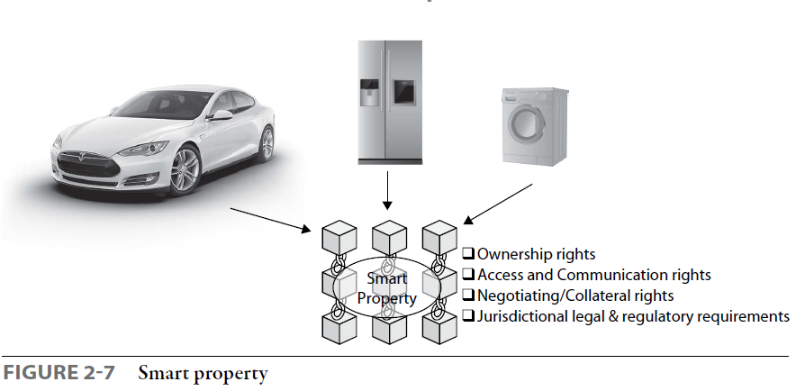
Smart Property

Slide 21
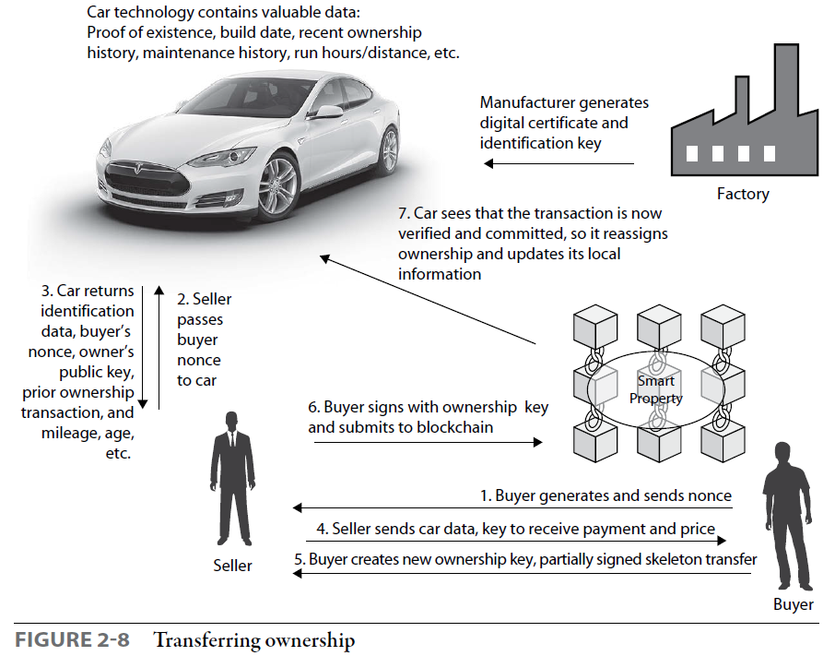
Smart Property

Slide 22
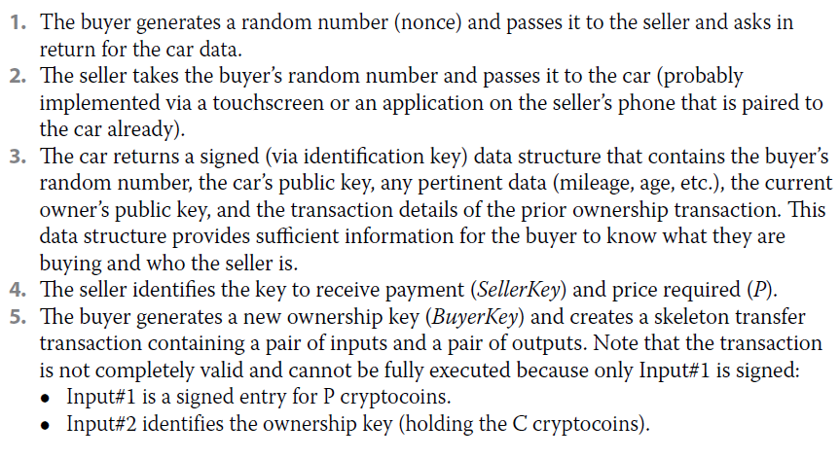
Smart Property

Slide 23
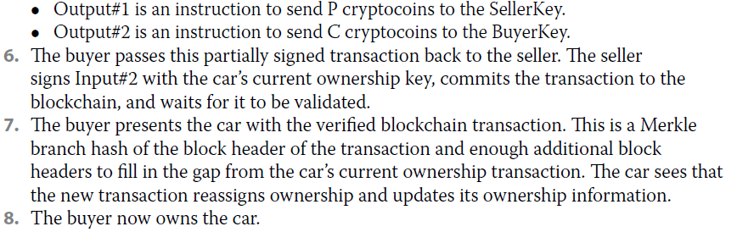
Smart Property

Slide 24
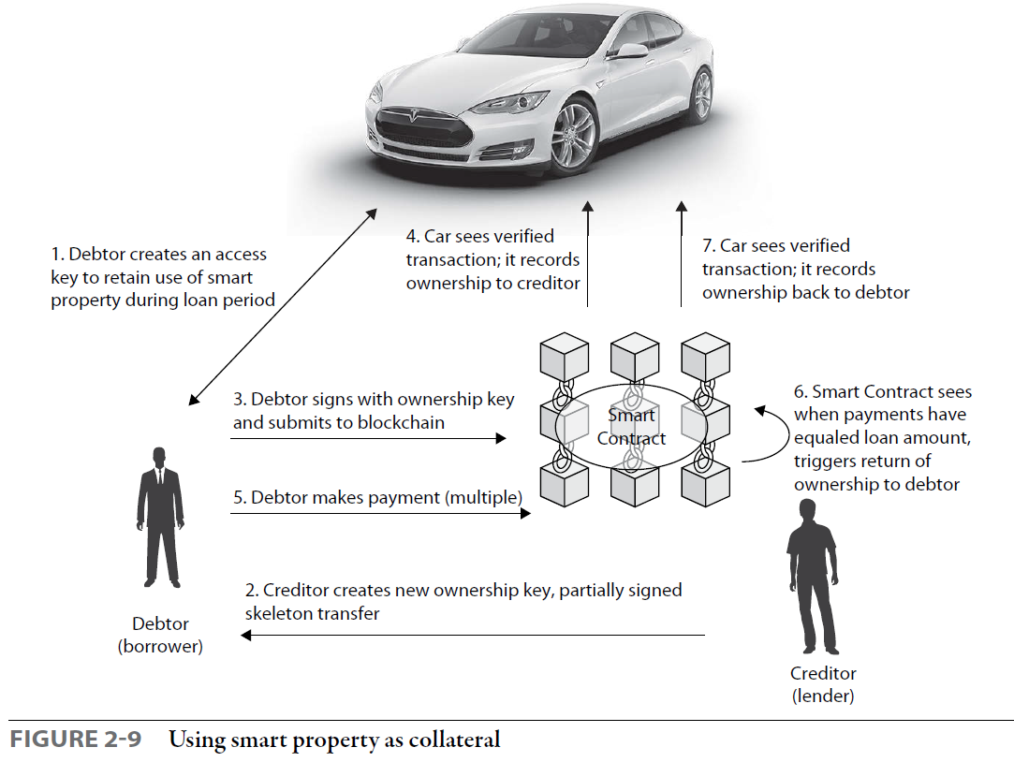
Smart Property

Slide 25
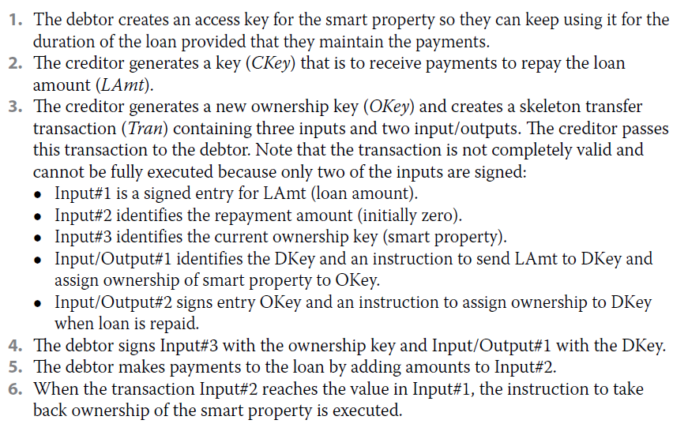
Smart Property

Slide 26
Smart Property
Financial Instruments | Records | Access (Ownership)
Currency | Records of: Spending, Trading, Mortgage | Security Tokens
Private Equities | Certifications: Business Licenses Birth/Death certificates, Passports | Keys to: Homes and Hotel Rooms
Public Equities | Voter IDs | Online Identities
Bonds | Health / Safety Inspections | Reservations (restaurants, hotels, queues etc)
Derivatives (futures, forwards, swaps, options and more complex variations) | Building permits | Vouchers
Commodities | Government/non-profit accounting/transparency | Music/Movies/Book Licenses/Softwares (DRM)

Slide 27
Coinprism
Coinprism, an online wallet service for “colored coins” founded in 2014, is closing its doors this weekend.
Coinprism was arguably ahead of its time. By using the bitcoin blockchain to create tokens representing other assets, its colored coins presaged the rise of ethereum and other networks built explicitly for such use cases.
“While we have been one of the first in the area of blockchain tokens, long before ethereum was even released, the ecosystem has since shifted towards ERC-20, which is more flexible and more powerful than bitcoin-based systems,” Founder CEO Charlon wrote.
https://www.coindesk.com/blockchain-startup-coinprism-to-shut-down-in-2-days

Slide 28
Reality check
“In 99% of use cases we’re seeing, blockchain is unfortunately a sub-optimal choice as a technology. Blockchains have many disadvantages in terms of speed, scalability, costs and user experience. Unless censorship resistance is a critical requirement (which it rarely is, especially in the enterprise blockchain space where participants all know each other), blockchain is rarely the right technological choice.”
The blockchain’s vaunted transparency, privacy and cryptographic security can all be achieved “quite easily” with a traditional system, Charlon went on to argue.

Slide 29
Financial Services- KYC
Know Your Customer (KYC) is the process by which a financial institution gathers information about a customer. The main purpose of this process is to ensure that institutions’ services are not misused, and this process takes place when a customer opens an account
Solution: The customer’s personal information, KYC documentation, and data are encrypted and added as a block in the blockchain

Slide 30
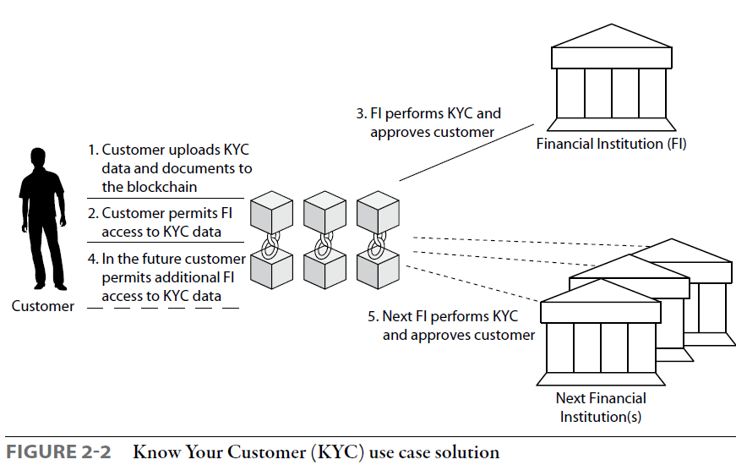
Financial Services- KYC

Slide 31
Asset Management Settlement Use Case
Problem: Typical back-office trade processing and settlement methods can be awkward, risky, and time consuming. This is especially the case when manual steps are involved, such as during matching and reconciliation tasks. Every entity in the value chain keeps its own copy, or view, of the transactions that have taken place.
Solution: The transactions can be stored in a blockchain and made available to all parties. A blockchain solution will remove the need for intermediaries and provides a trusted and shared (with permission) view of data:
Increase availability—no downtime
Reduce costs because there are fewer reconciliation issues
Speed up settlement because validation is fast
Improve transparency and ability to monitor

Slide 32
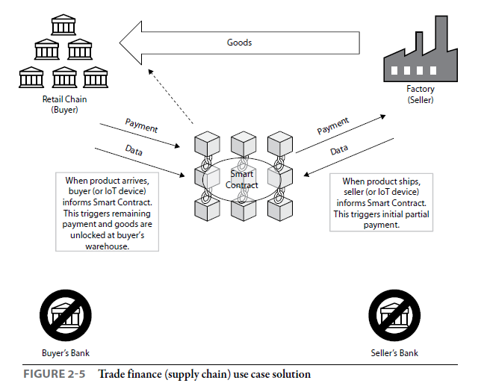
Trade Finance Use Case

Slide 33
Decentralized Cloud Storage
Allow users to rent unused hard drive space. Example: Storj and Filecoin
Proof of space (PoSpace), also called Proof-of-capacity (PoC) or Proof-of-storage, is a means of showing that one has a legitimate interest in a service (such as sending an email) by allocating a non-trivial amount of memory or disk space to solve a challenge presented by the service provide.
PoSpace is also being used in cloud storage technologies in which the peers contribute their free disk space and get service proportionately. However, peers can also get paid if they let their free space to be used by peers that need more space. Storj is a PoSpace based cloud storage example.

Slide 34
Storj
Storj (pronounced: storage) aims to become a cloud storage platform that can’t be censored or monitored, or have downtime. Storj is a platform, cryptocurrency, and suite of decentralized applications that allows users to store data in a secure and decentralized manner.
Network members where you can rent out unused or specially allocated hard drive space to other users in exchange for SJCX coins
https://www.storj.io/Storj-White-Paper-Executive-Summary.pdf

Slide 35
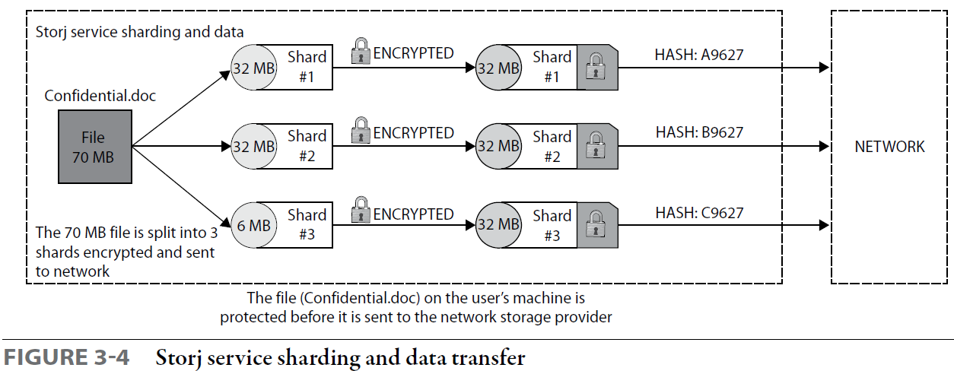
Stroj

Slide 36
Blockchain-based DNS
Advantages of blockchain technology:
The Absence of a Central server - a copy of the database is constantly distributed among the participants, therefore, it is almost impossible to hack it (except for “attack 51%”)
Each user has a complete database that contains the entire chain of blocks in encrypted form. Copies constantly and regularly synchronized.
Anyone can track any operation with data, the system is completely transparent.
Information in the chain (database) is added as new blocks. Adding agreed with other users of the network automatically.
Dmitry Bagay. Blockchain-based DNS building. Procedia Computer Science Elsevier. 169,, pp. 187-191. 2020

Slide 37
Blockchain-based DNS
Emercoin
Completely decentralized, EmerDNS is safe from any kind of censorship. No other user can modify your record — only the record creator can manipulate its content.
Domain name records are completely decentralized and uncensorable. They cannot be altered, revoked, or suspended by any authority. Only the record owner, i.e. the one who controls the private key to the associated payment address, can modify or transfer it to another owner.
https://emercoin.com/en/emerdns

Slide 38
Namecoin
Namecoin can store data within its own blockchain transaction database. The original proposal for Namecoin called for Namecoin to insert data into bitcoin's blockchain directly
.bit is a top-level domain that was created outside the most commonly used Domain Name System (DNS) of the Internet, and is not sanctioned by the Internet Corporation for Assigned Names and Numbers (ICANN). The .bit domain is served via Namecoin infrastructure, which acts as an alternative, decentralized domain name system.
Proposed potential uses for Namecoin besides domain name registration include notary/timestamp systems
https://en.wikipedia.org/wiki/Namecoin

Slide 39
Distributed Computation: Zennet
Zennet is a distributed supercomputing project that will use blockchain technology to remove the central administrators from the problem. Computation power is traded on Zennet’s open market platform. Anyone can rent computation power and use it to run arbitrary tasks. Anyone can monetize their hardware by offering unused computation power for sale.
Zennet allows “publishers” (those who need computation power) to run arbitrary computational tasks. Computation power is supplied by “providers” for a negotiated fee. A free-market infrastructure brings publishers and providers together.

Slide 40
Distributed Computation: Zennet
Publishers hire many computers and run whatever they want on them safely, thanks to cutting-edge virtualization technology. Payment is continuous and frictionless, thanks to Blockchain technology. The network is 100 percent distributed and decentralized: there is no central entity of any kind, just like Bitcoin.
All software will be open source. Publishers pay providers directly; there is no middleman. Accordingly, there are no payable commissions, except for regular transaction fees that are being paid to Xencoin miners. It is a totally free market: all participants are free to pay or charge by any rate they want. There are no restrictions.

Slide 41
Zennet
XenCoin is not a currency. It is not meant to be a method of payment used in everyday business transactions. Its purpose and design goal are to be a token for activating computational machines.
XenCoin has a real intrinsic value, as it is fully backed by the right to use a certain amount of computation power.
XenCoin can be monetized by using it to rent computational power used for mining cryptocurrencies. One may choose any cryptocurrency one likes, and this provides liquidity.

Slide 42
Decentralized messaging
Bitmessage is a P2P communications protocol used to send encrypted messages to another person or to many subscribers. It is decentralized and trustless, meaning that you need-not inherently trust any entities like root certificate authorities. It uses strong authentication which means that the sender of a message cannot be spoofed, and it aims to hide "non-content" data, like the sender and receiver of messages, from passive eavesdroppers like those running warrantless wiretapping programs
https://bitmessage.org/bitmessage.pdf

Slide 43
Bitmessage
a message transfer mechanism similar to Bitcoin’s transaction and block transfer system but with a proof‐of‐work for each message. Users form a peer‐to‐peer network by each running a Bitmessage client and forward messages on a best‐effort basis.
In order to send a message through the network, a proof‐of‐work must be completed. The existing proof‐of‐work requirement may be sufficient to make spamming users uneconomic
Just like Bitcoin transactions and blocks, all users would receive all messages. They would be responsible for attempting to decode each message with each of their private keys to see whether the message is bound for them.
Paired with the BitTorrent protocol, individuals could distribute content of any size.

Slide 44
Supply Chain Management
It is often identified that supply chains are opaque to consumers, with it becoming increasingly difficult to identify where products originated and where they travelled to.
Blockchain could be used in this instance as a transparent ledger that is available on each node and would create a formal log of tracking products in the supply chain
Every record on the blockchain network is immutable and timestamped, which makes it easy to track a product, prove its origin.
Participants at different points of the supply chain verify that the transferred products are genuine

Slide 45
Proof of existence, Document and Timestamping
Proof of Existence is just taking the hash of something and storing that hash in the Blockchain. Since the Blockchain stores all of the transactions confirmed and all hashes are unique, once that transaction is confirmed, it can be referenced again to prove that a particular document exists.
Proof of Existence will help to prove that a certain document/file/media was created on a particular date and time
Birth Certificate, Land Registry, Education Certificates, etc
Blockchain-based Proof-of-Existence Application by Toshendra Sharma

Slide 46
PoE: Land Registry
Georgia is the first country to implement the PoE technology in the public sector. They save the hash numbers of citizens’ land registry documents on the Bitcoin’s blockchain, which is currently the biggest of the blockchains.
This system protects citizens from the data leak, data manipulation and even the removal of it.
The hash number of the document, which is saved on the public blockchain, will always help Georgian citizens to prove that their documents are legit and valid. How ?
The document they provide should simply produce the same hash number as the one saved on the blockchain

Slide 47
PoE

Slide 48
Timestamping
OriginStamp is an internet platform that provides trusted timestamping based on decentralized blockchain technology. Users can anonymously create tamper-proof timestamps for all kinds of digital content. With the service, you can create, retrieve, and verify any timestamp recorded on the blockchain network.
After producing both the fingerprint and timestamp of the digital document, we have to submit it to the blockchain network
We can also download a timestamp certificate of this file for verification purposes. Within the document, we receive the name of the file, its hash, transaction, and even private key.
OriginStamp | Proof of Existence on Blockchain - The Complete Guide

Slide 49
Identity Management
We can imagine a world where an individual can register their identity in a cross blockchain fashion, providing a single namespace for lookup regardless of blockchain of choice
blockchain technology can offer three key features to an identity system: It's an immutable, trustless, and transparent agreed-upon network.
https://bitcoinmagazine.com/culture/microsoft-building-open-blockchain-based-identity-system-with-blockstack-consensys-1464968713

Slide 50
Government
Smart Cities
Central Banking
Validation of Education and Professional Qualifications
Tracking Vaccinations
Tracking Loans and Student Grants
Payroll Tax Collection

Slide 51
Anti-Counterfeit
LVMH is the first world-class player in fashion and luxury to adopt AURA blockchain technology for product authentication at scale.
Blockchain proposes to eliminate these doubts by identifying authentic products in a transparent and immutable online ledger using a ‘digital twin’, a virtual representation of a physical product that cannot be duplicated or modified.
Because a digital twin cannot be assigned to more than one physical product, and cannot be forged, the diffusion of blockchain protocols is expected to vastly improve supply chain and product transparency.
https://brands.certilogo.com/hubfs/Downloadable%20Content/Making%20Blockchain%20Real.pdf?utm_source=luxe.digital
https://www.everledger.io/blockchain-luxury-goods-helping-to-improve-trust-and-sustainability/

Slide 52
Property Securitization
Tokenization is a term used to describe the process of digitizing an asset.
In property tokenization, the property value is converted into digital tokens with the help of special blockchain real estate tokenization platforms. These tokens, often referred to as “security tokens”, normally represent shares of a real estate property.
When the token is offered for sale on the market, it can then be purchased by investors who will be given fractional ownership of the property. These investors also have the right to sell as many shares as they need and/or want

Slide 53
Property Securitization
Tokenization gives better liquidity, lower entry cost, greater transparency
Tokenization of real-world assets gives investors a chance to securely trade the whole or a fraction of the commodities they own
Real estate tokens qualify as securities as such would be regulated by state and federal law
Since blockchain technology eliminates multiple intermediaries, it has become easier for buyers and sellers to interact with each other. In addition, fractional ownership is still possible in this industry.
https://pixelplex.io/blog/real-estate-tokenization/

Slide 54
Asset Tokenization
Asset tokenization is a way of digitizing tangible and intangible assets and converting them into tokens, which are then stored on the blockchain. One asset is not generally equal to one token: assets are usually broken down into smaller parts, which form many tokens.
Once the owner has tokenized their assets and they have entered the digital world, it becomes possible to store and trade them fractionally or completely, as well as transfer them to other owners.
https://pixelplex.io/blog/what-is-asset-tokenization/

Slide 55
Tokenization - Entertainment
In 2020 basketball star Spencer Dinwiddie tokenized part of his $34-million contract with the American professional basketball team Brooklyn Nets, creating a unique tokenized investment opportunity. This was done through the Dream Fan Shares platform based on the Ethereum blockchain.
Spanish club Barcelona has also recently joined the wave of blockchain adoption. The club invited fans to buy 600,000 tokens based on a Barcelona cryptocurrency, worth €2 each. Owning these tokens would give Barça fans exclusive voting rights in club polls and the chance to win awards, including meeting their favorite players. In the end, the Spanish champions earned €1.2 million in less than two hours and increased fan engagement.

Slide 56
Tokenization - Entertainment
Rapper Redfoo, one of the performers of the hit “Party Rock Anthem” signed a contract with TokenStars.
This platform aims to provide transparent interactions between celebrities, fans, brands, and advertisers.
Lothar Matthaus, Vinny Lingham, Tommy Haas, and several other celebrities have also joined the project

Slide 57
Tokenization - Ecology
In 2020 Moss.Earth, a Brazilian environmental organization suggested tokenizing carbon credits to create a global environmental market. Moss has introduced its own MCO2 tokens and put them up for sale.
Through this project, Moss has made a direct contribution to offsetting the emission of 2 million tonnes of greenhouse gases. In just the first 8 months since the platform’s launch, Moss has bought and sold over 900,000 tonnes of CO2.
The campaign that involves the MCO2 token helped pay rewards for the conservation of nearly 1 million hectares of forest

Slide 58
Tokenization - Ecology
They are issued with the specific purpose of attracting investment for projects with positive social and environmental impacts. Plastic Bank, for instance, is an asset tokenization solution that is meant to make our world a better place.
Collectors are recruited to collect plastic in places where there are problems recycling it. The plastic waste is then exchanged at local collection centers for cash, digital tokens, or vouchers for essential items.
To date, company employees have collected 31,124,187 pounds of plastic, the equivalent of over 500 billion plastic straws.

Slide 59
Tokenization - Individuals
In April 2020, Alex Masmej, a 23-year-old guy from France, sold $1 million worth of $ALEX personal tokens on Ethereum. In total, he managed to collect $20,000. The young man stated that holders of $ALEX tokens will receive a distribution of 15% of his income over the next 3 years, and the money will be paid quarterly.
Matthew Vernon, or dApp Boi, is a talented designer who is obviously a big fan of the crypto world and blockchain technology. Matthew created BOI tokens worth $100 representing 100 hours of his time. These tokens can be traded for UI/UX design, prototyping, brand design, or anything else related to Matthew’s professional career.

Slide 60
Tokenization -Resources
Natural Resources such as Gold, Silver and Energy.
Tokenized gold and silver is easy to trade and convert.
Blockchain-based tokenization platforms are now being used to avoid high management costs in dealing with many small investors, while opening the door for oil and gas companies to attract even wider and more diverse investment audiences.

Slide 61
Tokenization -Art
Maecenas is an art investment platform that allows artists to tokenize their masterpieces and build their own portfolios. In addition, Maecenas enables any art lover or investor to acquire fractional interests in works of art using blockchain technology.
Monart represents an innovative international art community and marketplace and invites investors to buy shares in great artwork collections to capitalize on the growth of the art market. The platform offers its own token called MART.

Slide 62
Characteristics of Blockchain
Resiliency and Tamper Resistance
As long as there is an Internet connection, a blockchain can be replicated, and the network can be rebuilt. As soon as Internet connectivity is restored, parties in those previously excluded regions can update their personal copies of a blockchain and continue to participate in the network, picking up where others have left off.
Beyond being resilient, blockchains store information that is highly resistant to change.
The tamper-resistant and resilient nature of blockchains also creates complications
For governments and regulators. Unless a government can succeed in taking over a blockchain or can convince miners and other relevant stakeholders to modify a blockchain’s protocol, any data or programs stored on a blockchain cannot be altered,
De, Filippi, Primavera. Blockchain and the Law : The Rule of Code, Harvard University Press, 2018. ProQuest Ebook Central,

Slide 63
Characteristics of Blockchain
Transparent and Non-repudiable Data
Information maintained on a blockchain is authenticated, and metadata and other contextual information about blockchain-based transactions are available for others to view.
All transaction data stored on a blockchain is not just auditable but also authenticated and non-repudiable.
Because blockchains rely on public-private key encryption and digital signatures, once a transaction occurs on a blockchain-based network, parties subject to that transaction will have a hard time denying involvement.
This helps create trust in the network.

Slide 64
Non-repudiable Data
In late 2016, questions swirled about whether Julian Assange, the prominent cypherpunk and founder of Wikileaks, was still alive. Conspiracy theories about his death bounced around the Internet, including stories posted to online communities like Reddit and 8chan.
Assange managed to counteract these rumors without making any public appearance. He used a Bitcoin address widely known to be associated with WikiLeaks to execute a series of transactions with the following hidden message: “We’re Fine. 8 Chan Post [is] Fake.”
The blockchain provided the necessary infrastructure to prove the integrity of the message and the authenticity of its source, in a way that could not easily be repudiated.

Slide 65
Non-repudiable Data
By implication, private actors and governmental authorities have the option to store authenticated information on a blockchain, making the information available worldwide to anyone with an Internet connection.
Government records no longer need to be stored on paper or in centralized silos; they can be digitized and stored on a blockchain for the benefit of the public.

Slide 66
Pseudonymity
By relying on digital signatures and public-private key cryptography, blockchains make it possible for a person to store information or engage in transactions without revealing one’s true identity.
With blockchains, parties can interact with one another even if they do not trust each other—provided that they trust the underlying technical infrastructure and the rules embedded in a blockchain’s protocol

Slide 67
Distributed Storage
Blockchains, however, are capable of storing more than mere records About the transfer of digital currencies. They can store data, messages, votes, and other kinds of information that can be encoded in a digital format.
For instance, the Bitcoin blockchain has been used as a repository for different kinds of information—from prayers and eulogies to messages and images ranging from the sophomoric to the sublime.
More generally, a blockchain can be regarded as a shared repository of information—an open, low-cost, resilient, and secure storage system that nobody owns but many people maintain.

Slide 68
Trustless Consensus
Another core characteristic of blockchains is their ability to coordinate social activity and help people reach an agreement as to a particular state of affairs.
Consensus mechanisms make it possible for a distributed network of peers to record information to a blockchain, in an orderly manner, without the need to rely on any centralized operator or middleman
Because data recorded on a blockchain is visible to all and is hard to repudiate and retroactively modify, groups of people who do not know—and therefore do not Trust—one another can rely on this new data structure to coordinate their activity, with less of a need for trusted authorities.

Slide 69
Distributed Governance
An organization can use a blockchain to reach consensus and use smart contracts to govern contractual relationships and facilitate payments between parties.
Because blockchains help people reach consensus, they may help solve some of the issues traditionally associated with shared common-pool resources—such as the free-rider problem or the tragedy of the commons.

Slide 70
Distributed Governance
Transparent data storage and smart contracts could be used by communities to help them reach an agreement and self-govern.
For instance, by recording every interaction on a public blockchain and encoding rules linking these interactions to specific transactions—such as the assignment of tokens or the allotment of small payments of digital currency—blockchains can help commons-based communities govern themselves through decentralized incentive systems.

Slide 71
Government Platforms
Bitnation is a decentralized platform for Governance 2.0. It is a political experiment from a voluntary, transnational and borderless perspective, which explores new democratic and social processes using the Blockchain technology.
This platform was deployed in July 2014
https://www.youtube.com/watch?v=aPNZsAD6o0g (I did some work)
Martínez et al. The “Tokenization” of the eParticipation in Public Governance: An Opportunity to Hack Democracy. J. Prieto et al. (Eds.): BLOCKCHAIN 2019, AISC 1010, pp. 1–10, 2020.

Slide 72
Government Platforms
Consul is the most developed citizen participation tool to date for open government projects in municipal environments. It is developed in free software (its code is complete in GitHub) and has established the DECIDE platform to manage the eParticipation systems that it integrates. It is in use in 33 countries, and is used by 100 institutions such as the municipalities of Madrid (Spain), Paris (France) and Buenos Aires (Argentina).
Martínez et al. The “Tokenization” of the eParticipation in Public Governance: An Opportunity to Hack Democracy. J. Prieto et al. (Eds.): BLOCKCHAIN 2019, AISC 1010, pp. 1–10, 2020.

Slide 73
Autonomy
Blockchains are characterized by their ability to facilitate the deployment of autonomous software that is not under the control of any one party.
By relying on a peer-to- peer network and a consensus mechanism, they facilitate the execution of computer code in a way that is entirely independent of any one party
Blockchains thus enable the creation of autonomous software programs run through the collaborative effort of parties with different incentives and in different locations scattered across the globe, none of which can unilaterally affect the code’s execution.
Once deployed on a blockchain, these programs no longer need or necessarily heed their creators; they are run on a decentralized network, making it difficult to unwind or halt their execution

Slide 74
Autonomy
These blockchain-based systems can reduce or even eliminate the need for human oversight, narrowing the possibility for parties to act opportunistically in ways that benefit the few at the expense of the many.
Systems deployed on a blockchain are not subject to pressure by government.
These blockchain-based systems can “serve as the foundation for more sophisticated types of decision making, allowing legal institutions to be created without voting or the designation of a central authority.”
Traditional legal doctrines, especially those focused on regulating middlemen, will not easily translate to these new decentralized and autonomous systems

Slide 75
Rule of Code
There would no longer be centralized institutions and hierarchical structures but rather informal systems of (often invisible) rules dictated by programmers deploying code.
The growing reliance on algorithms to shape our interactions with one another and with third-party operators would increasingly subject us to the “rule of code” as opposed to the “rule of law”
It could be used to enable individuals to self-govern and deviate from long-standing legal rules.

Slide 76
Decentralized Organizations
Blockchain technology enables the creation of decentralized organizations consisting of individuals who gain the ability to cooperate or collaborate on a peer-to-peer basis—and, if desired, to transact value—with less of a need to rely on a centralized management structure.
At their most basic level, decentralized organizations operate via blockchain-based tokens and smart contracts, which grant people control of an organization’s assets either directly or indirectly.

Slide 77
Decentralized Organizations
Every token can be imbued with specific rights, such as the right to a portion of an organization’s profits or losses or the rights to access, manage, or transfer the resources or services that an organization controls.
Tokens can also be associated with specific privileges, providing people the opportunity to engage in an organization’s decision-making processes.
If individuals purchase or hold tokens in a decentralized organization, they automatically become members, with membership rules defined—at least in part—by the underlying smart contract code.

Slide 78
Decentralized Organizations
Consider, for example, the popular ride-sharing service Uber. At its most basic level, Uber coordinates a loose network of drivers by using a centrally maintained online platform.
A decentralized organization could coordinate the same activity without the need for a central operator. Drivers could receive tokens from a new, blockchain-based organization that relies on smart contracts to manage ride requests published to a blockchain.
Smart contracts could structure a decentralized application, set a market price for rides, match drivers and riders, handle payments, facilitate ratings, and define transparent rules for the organization’s management

Slide 79
Decentralized Organizations
This new organization could be designed to be self-sufficient, borderless, and open to drivers around the world.
Drivers could vote to deploy to build and maintain any necessary software.
if each driver has voting rights, the decentralized organization could presumably operate in a way that is more favorable to drivers’ interests.
This is sometimes also known as Sharing Economy

Slide 80
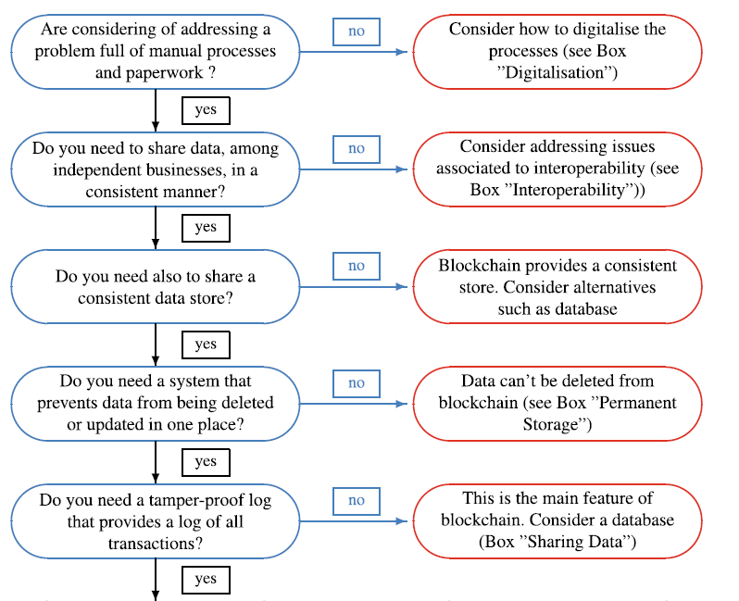
Do you need a blockchain?
Vigliotti M.G., Jones H. (2020) Blockchain Strategy. In: The Executive Guide to Blockchain. Palgrave Macmillan, Cham. https://doi.org/10.1007/978-3-030-21107-3_7

Slide 81
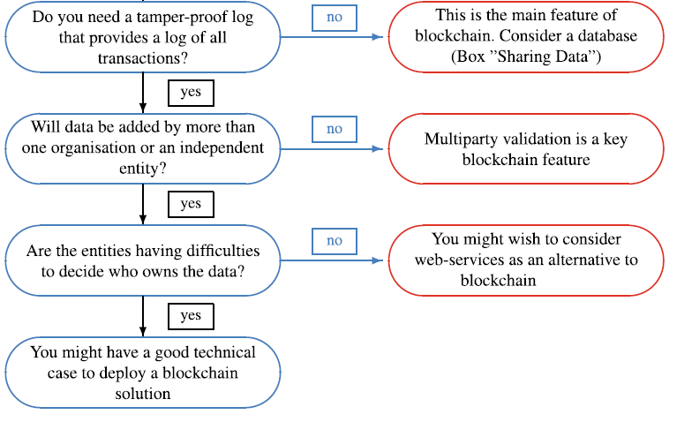
Do you need a blockchain?

Slide 82
Questions to Ask
Will the system scale to the size of your data? How?
How do you deal with human error in the “immutable” blockchain or smart contracts?
If this is for working with people you trust less than the people you deal with now, how are they assuring the security of the chain – what’s the security threat model?
What does this get you that a centralized database can’t? How, precisely?
Who enters the data? How is the data verified? (The oracle problem.)

Slide 83
Authenticity Problem
Information that is not native to the blockchain we cannot guarantee its authenticity at the moment of registration.
If copyright ownership information is entered incorrectly, either deliberately (by a bad actor) or mistakenly (due to human error), it is unclear how conflicts would be resolved without a trusted third party.
Although it can store information in a robust and immutable manner, blockchain technology alone cannot confirm the authenticity of the registered information.
Ito & Dair. A Critical Examination of the Application of Blockchain Technology to Intellectual Property Management. Pp317-333, 2019 . In H. Treiblmaier, R. Beck (eds.), Business Transformation through Blockchain, https://doi.org/10.1007/978-3-319-99058-3_12. Palgrave Macmillan.

Slide 84
Provenance Problem
There is an expectation that blockchain can facilitate the transfer of IP without requiring a TTP, and that it can overcome the problem of ‘piracy’ through issuing a digital certificate or a secret key to access digital contents.
Physical assets such as paintings, for example, can easily be transferred between owners without updating the information stored in a ledger; moreover, even digital assets are replicable for a temporal owner who has the private key. Needless to say, once IP is transferred outside the network, records in the ledger no longer provide a reliable certificate of ownership.

Slide 85
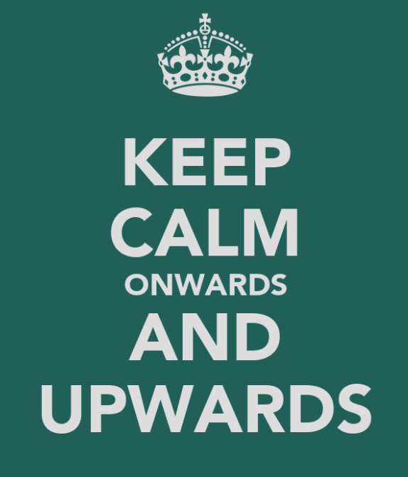

Next ..
Smart contracts
IOT – Internet of Things
Voting
DAO – Decentralized Autonomous Organizations
DeFi – Decentralized Finance
And others .. onwards

